Slide 1
Install Hadoop With Virtualbox

Slide 2
Install Virtual Box
Go to this website to download VirtualBox 6.1.18
https://www.virtualbox.org/wiki/Downloads
Choose your OS (Windows or OS X)
Then Install VirtualBox

Slide 3
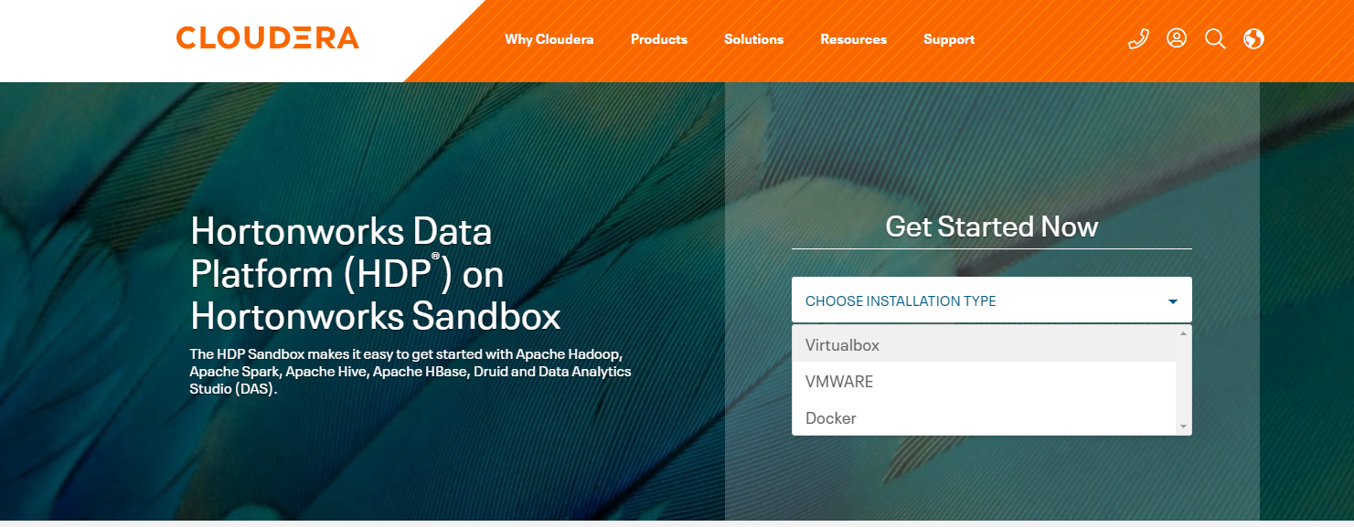
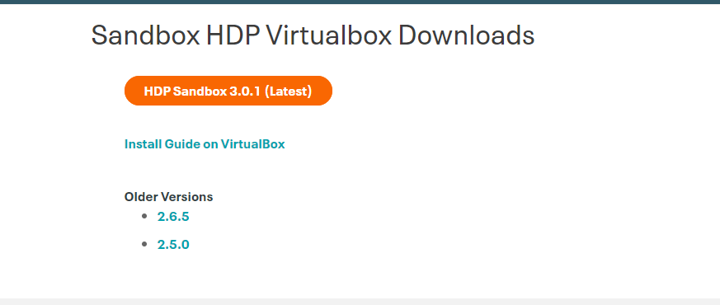
Download Hortonworks HDP
Go to https://www.cloudera.com/downloads/hortonworks-sandbox.html to download Hortonworks HDP
Choose the VirtualBox installation type
The download file is more than 20G, so take a while to download.
You also need to create an account with CLOUDERA by following the download steps

Slide 4
Import the Downloaded Image to VirtualBox

Slide 5
Setting of The Virtual Machine
Set the number of CPU and RAM to fit into your computer if needed

Slide 6
Import the VM is done
Click this to launch VM. The first launch may take a quite a while.

Slide 7
Very patiently wait for this process to complete
In my computer, it took about 1.5 hours
It only takes that long in the first boot

Slide 8
Done!
Open browser and go to
http://localhost:1080

Slide 9
After clicking this,
You will see a webpage for login, use the following:
User: maria_dev
Passwd: maria_dev

Slide 10
Then, you will see the dashboard of the system
It may take times for the metrics to show up

Slide 11
Now, open another browser and go to
http://localhost:4200
You will see a terminal interface for ssh.
User name: root
Initial passwd: hadoop
You will be prompt to change your passwd

Slide 12
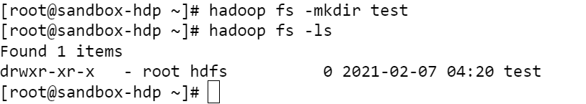
Issue the following command on the above terminal:

Slide 13
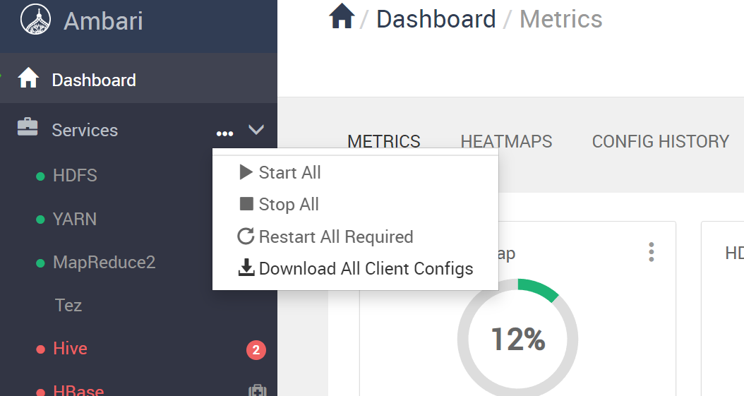
To Stop the VM
It is important to stop the VM properly, your VM instance may be corrupted otherwise
Stop all services in Ambari dashboard
It takes times for all services to stop
Issue “sudo shutdown now” in the ssh window
Select ACPI Shutdown in the VM instance

